Slide 1
BAGGAGE TACKING IN DOMESTIC AIRPORTS
GUIDE
Prof. WINSTON PAUL D
Assistant professor
Department of IT
KARTHICK U 15EUIT048
FAHEEN FATHIMA B N 15EUIT030

Slide 2
OBJECTIVE
The project mainly involves writing and reading of RFID tags on baggage at airports. once the tag is read, an SMS is sent to the passenger on the whereabouts of baggage.

Slide 3
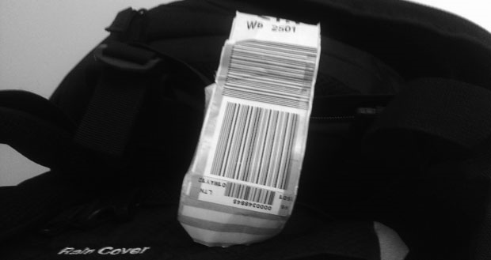
EXISTING SYSTEM
The baggage is tagged with barcode tags that is scanned manually by the authority.
DRAWBACKS:
Manual scanning of the bags
Inappropriate calculation of time
Lack of data flow.

Slide 4
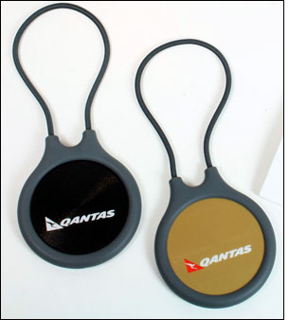
PROPOSED SYSTEM
Using RFID tags to track the bags and send an SMS using the GSM module using the ARDUINO microcontroller.
ADVANTAGES:
Automatic flow of data .
Exact calculation of time.
Accuracy of position of baggage

Slide 5
DATA FLOW DIAGRAM
PASSENGER
1:1
STORE
MAIN DATABASE
D
ARDUINO+RFID
1:2
VERIFY
TAGS
T
ARDUINO+GSM
1:3
SEND SMS
PASSENGER

Slide 6

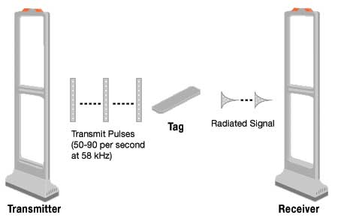
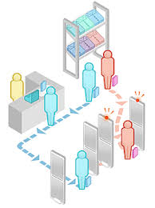

TAGGING THE BAGGAGE
VERIFICATION OF TAGS
PROTECTION OF BAGS
SENDING AN SMS

Slide 7
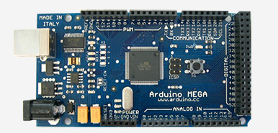
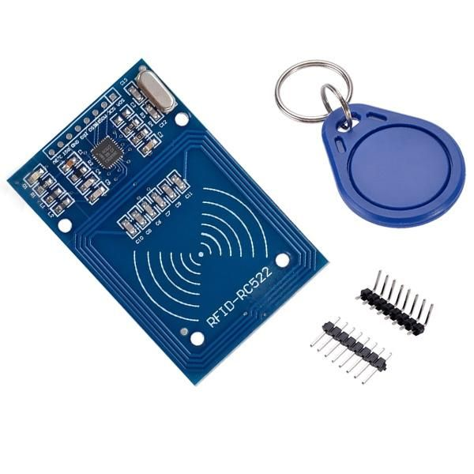
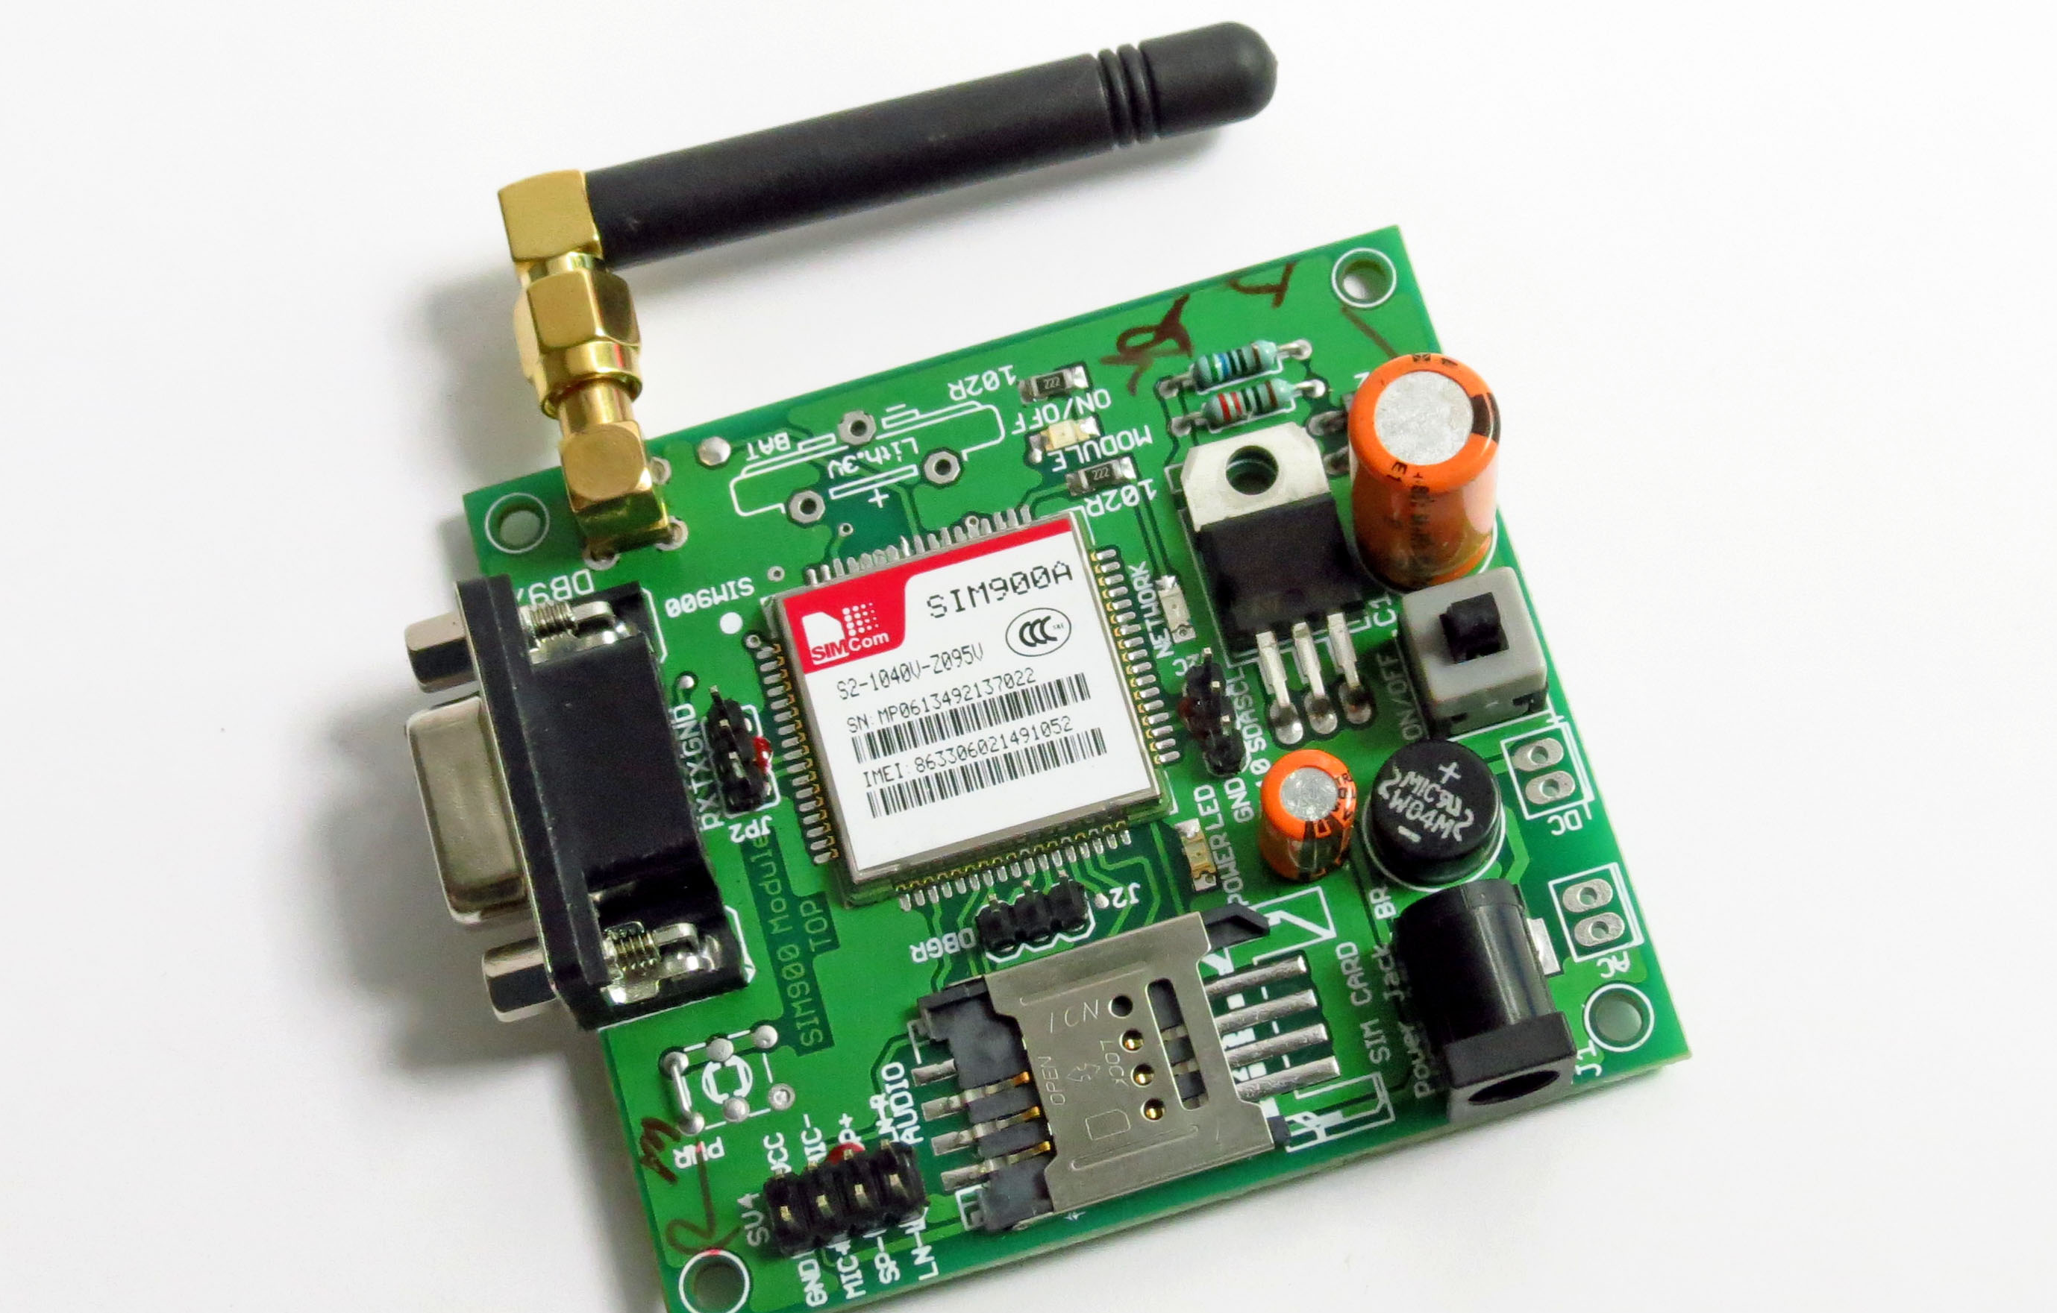
MODULES
ARDUINO MEGA
RFID MODULE
GSM MODULE
IT’S A MICROPROCESSOR WITH OPEN SOURCE PROGRAMMING
IT ENABLES TO READ / WRITE RFID TAGS TO STORE DATA UPTO 1KB
THIS ENABLES US TO SEND SMS IN MICROPROCESSOR SYSTEMS

Slide 8
IMPLEMENTATION
WRITING THE RFID TAGS
Use the arduino language to program the RFID tags.
Tags data is changed with the passenger details(phone number).
Among various sectors, appropriate sector (sector 4) is used to write the data.
The RFID reader reads the data from the tag

Slide 9
THANK YOU☺

